Slide 1
Robot Design & Competition
Team Cosmo
Team members
210069F
210174X
210205V
210258J
210542B

Slide 2
.
Mechanical design
Robot Mechanics: The Heart of Our Design

Slide 3
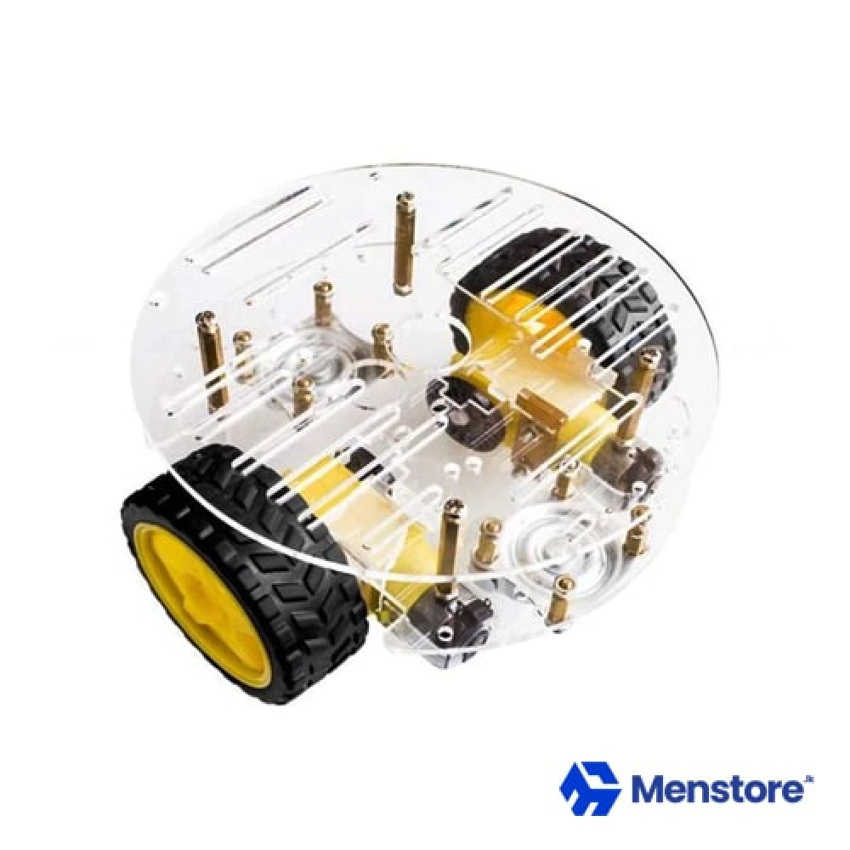
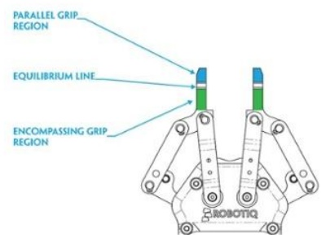
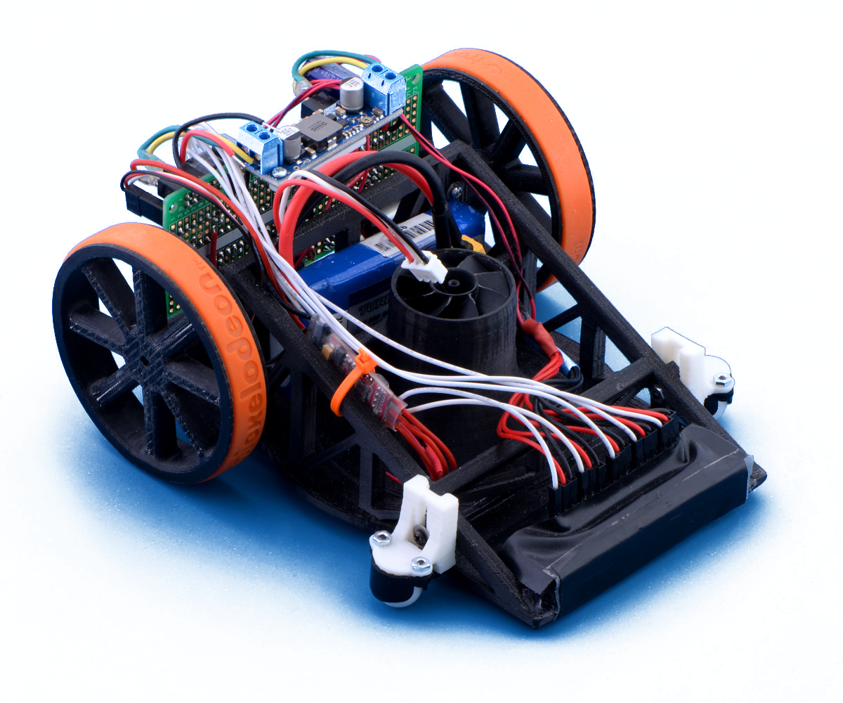
Mechanical design
2 wheel design
Mechanical arm
2 supporting wheels
robot design offers greater agility and simplicity, reducing cost and complexity compared to four-wheel designs with wheel encoders.
Mechanical arms on two-wheel robots enable precise manipulation, enhancing adaptability for various tasks, making them preferable.
Our 2-wheel robot design features 2 front supporting wheels, preventing collisions during the slope-climbing phase.

Slide 4
Overall strategy:
How We Guide Our Robot to Do Its Job: A Simple, Effective Plan

Slide 5
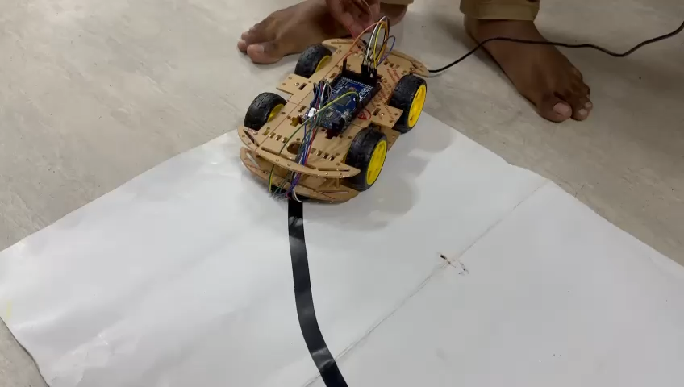
Overall strategy:
PID Control
Level increment
Main Method of Movement
When IR arrays light up, move the bot 5 cm forward for confirmation.
Turns at checkpoints
If uncertain on white boxes, try all 3 directions to find a way. (Path finding algorithm)

Slide 6
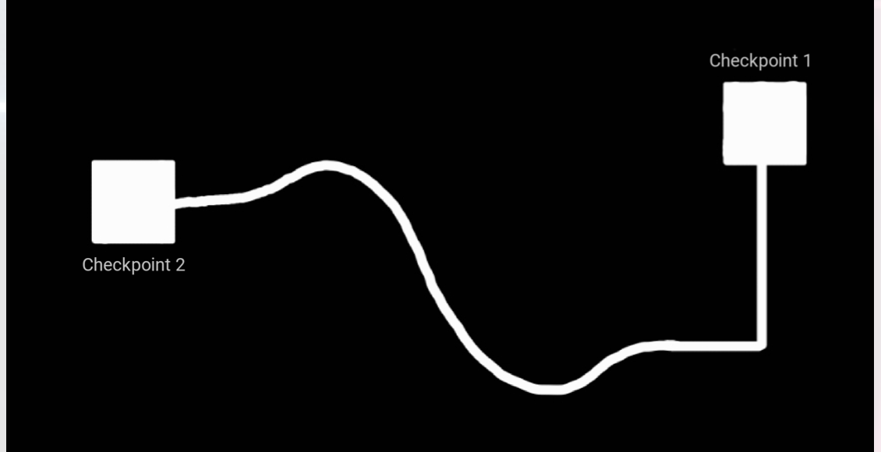
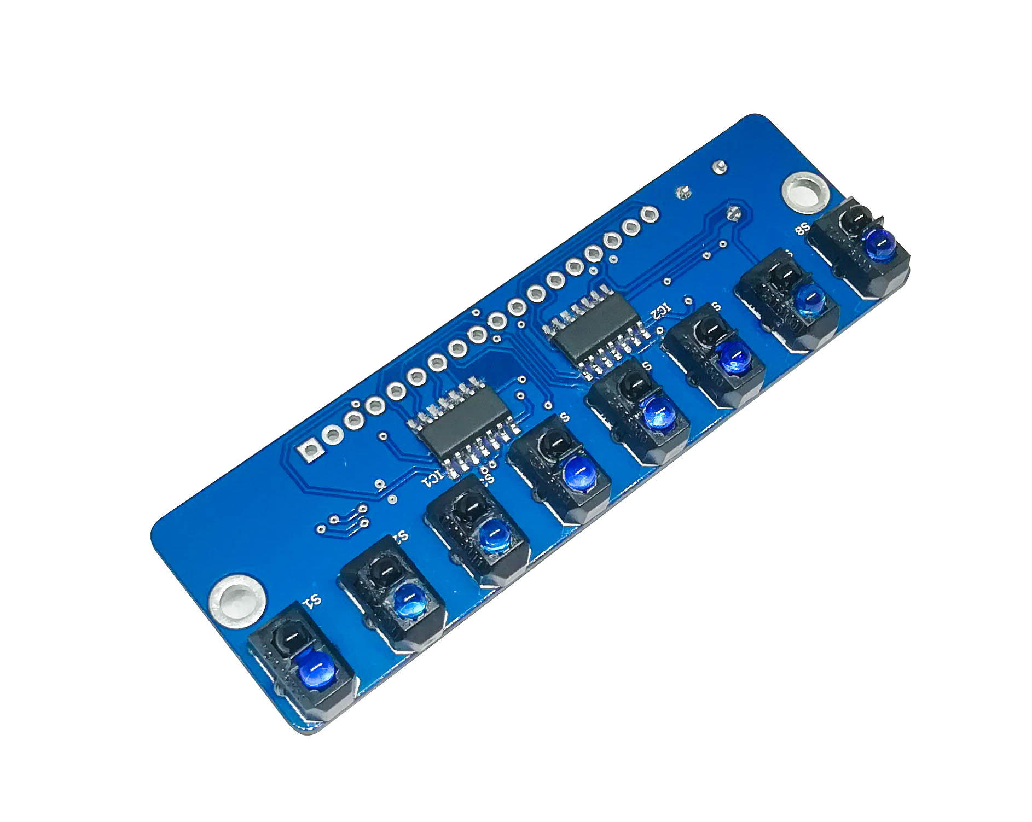
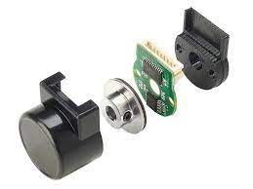
Subtask 1
Calibration
PID control
Bend detection algorithm
Turning 90 degrees using encoder readings
Sensors
Aptinex IR 8x array
Magnetic motor encoders
white square detection
&
Level increment
PID control
Bend detection
algorithm

Slide 7
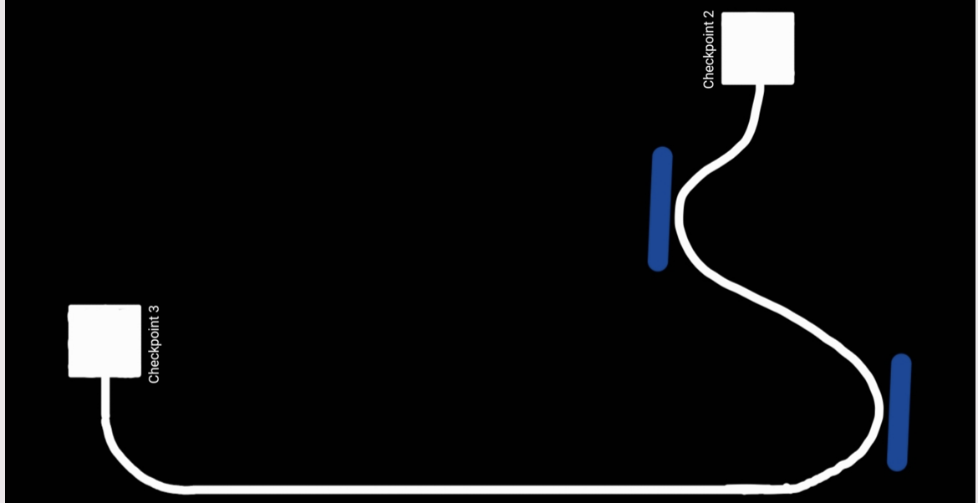
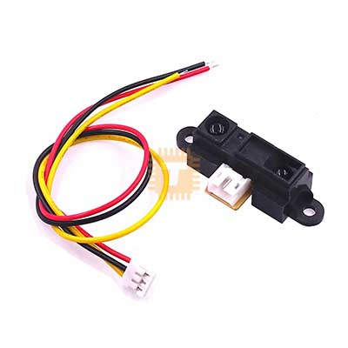
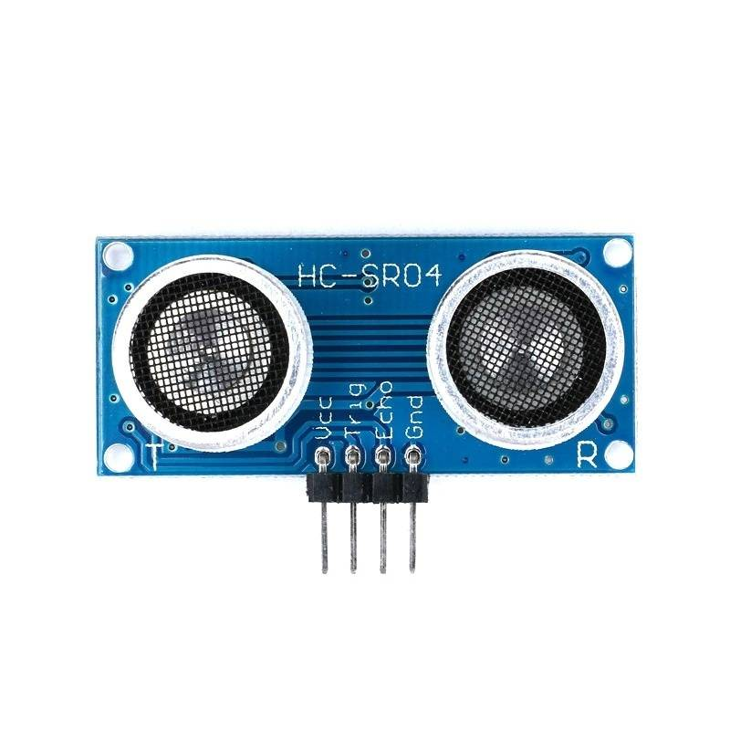
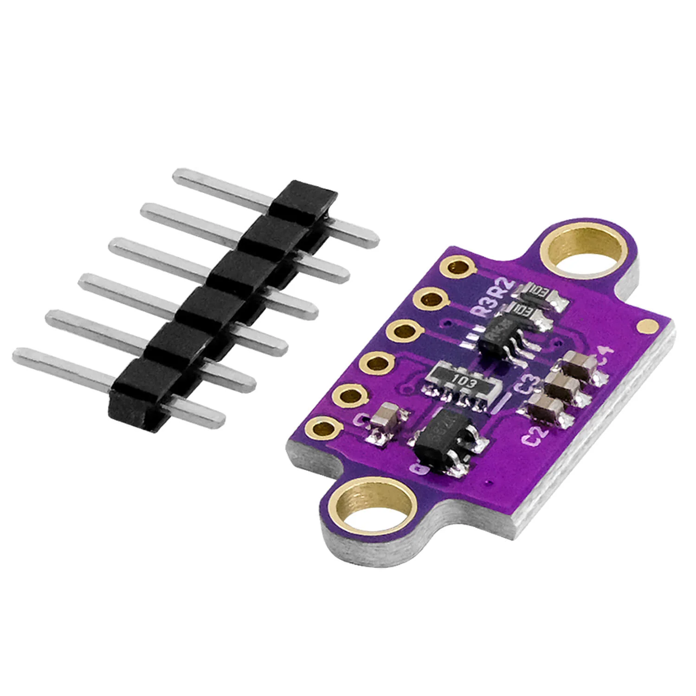
Subtask 2
PID control
Distance sensors at the front to detect the walls
Distance sensors at the side to keep a constant distance from walls
Sensors
Sharp IR sensors
Ultrasonic sensors/ToF(Time of Flight) sensors
Path finding
algorithm
white square detection
&
Level increment
Keeping constant distance from the walls
PID control

Slide 8
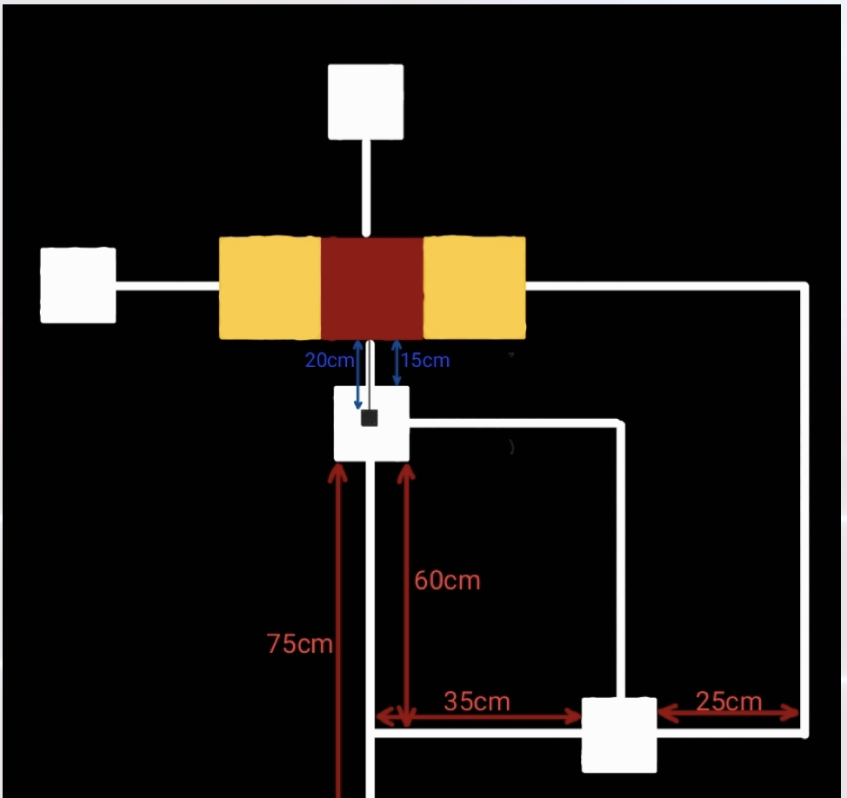
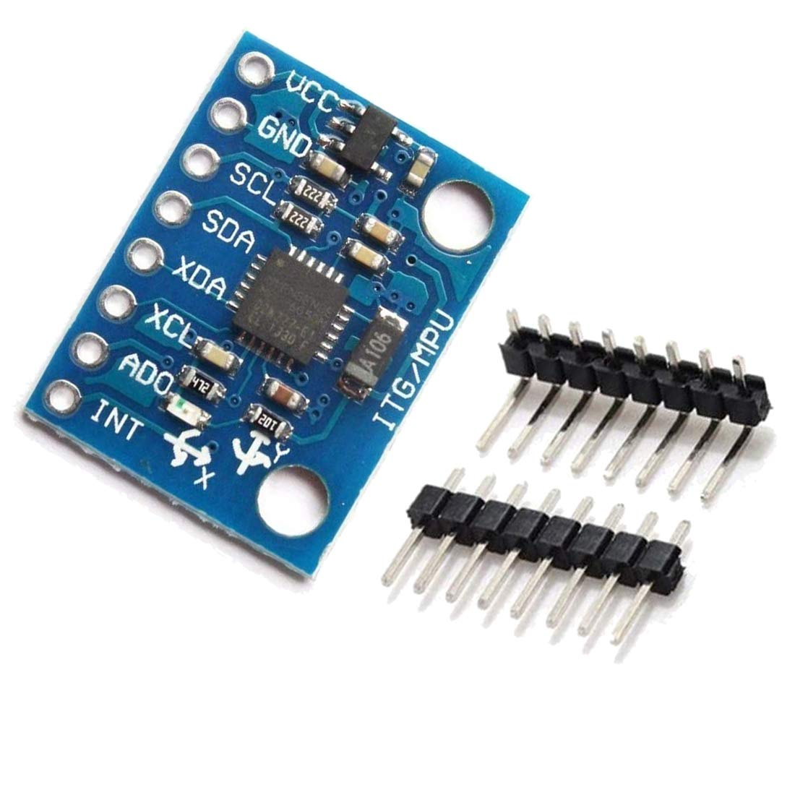
Subtask 3 - A
Turning off all non-using sensors
Angle measuring sensors to move straight on the ramp + wheel encoders for straight movements
Using IR array readings in case the robot moved out of the ramp
Sensors
Gyroscope (MPU6050)
Deactivating all non-using components
Encoder readings + gyroscope +IR array readings synthesized to keep moving straight
Bend detection
algorithm
white square detection
&
Level increment

Slide 9
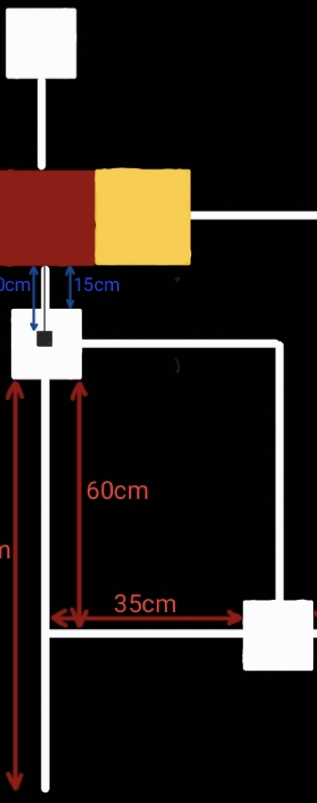
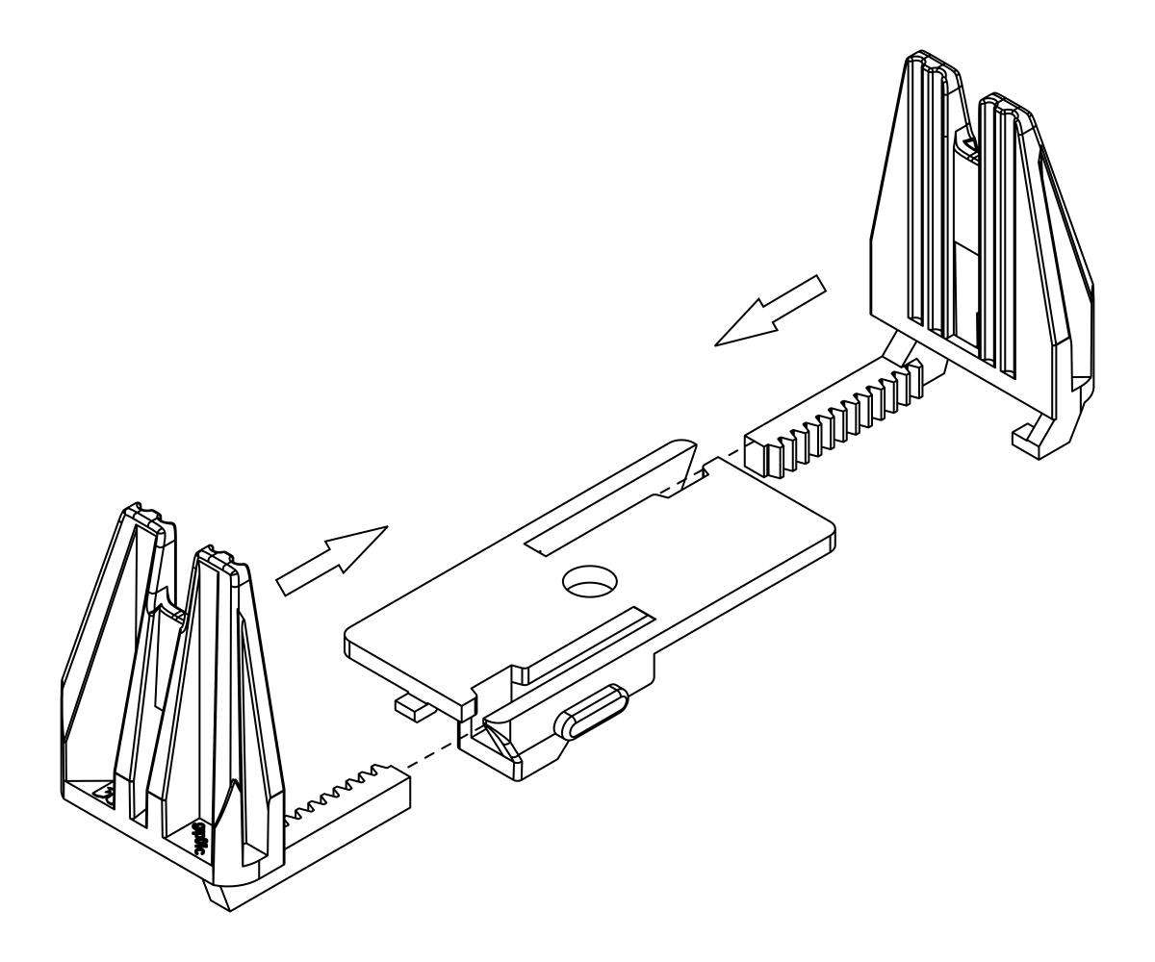
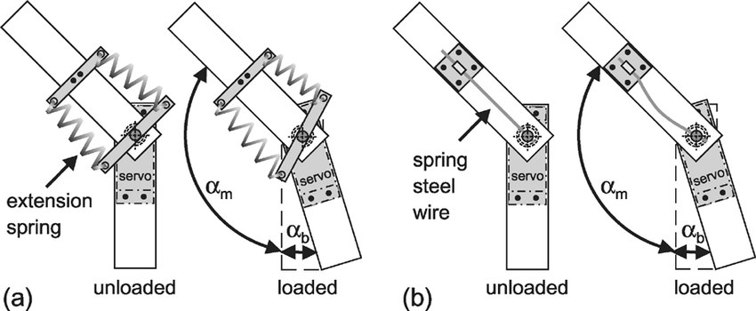
Subtask 3 - B
white square detection
&
Level increment
Algorithm to detect T junction
Use predefined lengths to move to desired locations
Mechanical arm to grab the object (which can slide up at idle)
Grabbing the object and pulling back with the arm, travelling across pre-defined bends
Sensors
Sharp IR sensor
Actuators
Servo based joints
Mechanical arm to grab and pull a known distance
Junction detection
Algorithm
(once detected moving forward to reconfirm)
Path finding
algorithm

Slide 10
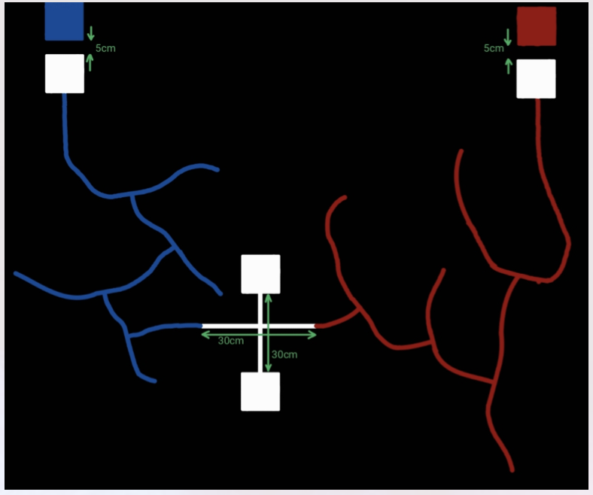
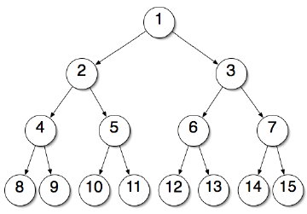
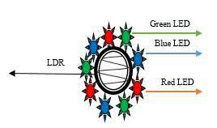
Subtask 4
Cross junction detection algorithm
Distance sensor to identify the box and color sensor to scan color
Node tree algorithm to traverse through the maze
Analog IR readings to detect blue and red lines
Unloading the load using predefined lengths (encoder readings)
Sensors
Home-made color sensor (LEDs and LDR)
white square detection
&
Level increment
white square detection
&
Level increment
Once detected moving forward to reconfirm and encders to get a 180⁰ turn
Traversing left/right with a node tree
Junction detection algorithm

Slide 11
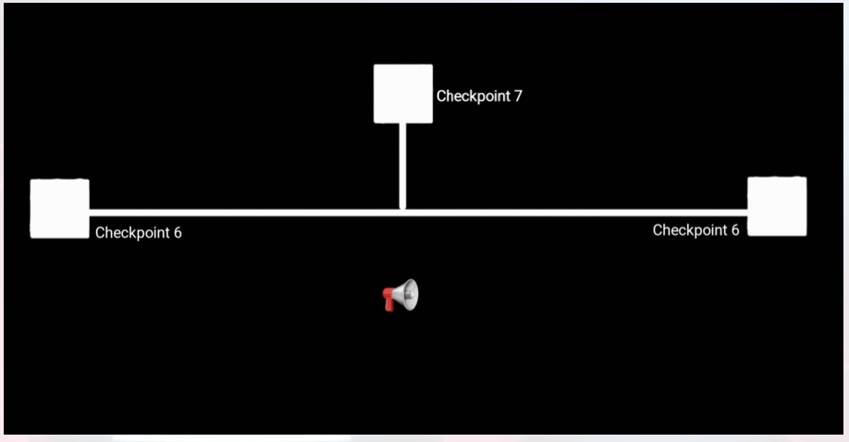
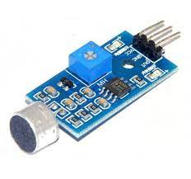
Subtask 5
white square detection
&
Level increment
Sound sensor to trigger movements
Deciding the direction to turn by pre-chosen color
Bend detection algorithm
Sensors
Sound sensor
Bend detection algo
Sound sensor triggering movements

Slide 12
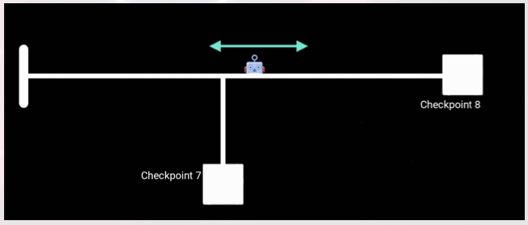
Subtask 6
Front sharp IRs to detect the movement direction of the guard robot
Bend detection
Sensors
Sharp-IR sensors
BEND DETECTION
While waiting… Sharp-IR sensors are used to detect the motion of the guard robot
white square detection
&
Level increment
TRIGGER MOVEMENTS WHEN THE GUARD ROBOT DETECTED TO BE MOVING LEFT

Slide 13

Task delegation
cosmo
Yasiru
cosmo
Hasitha
Mechanical Design, Maze Traversal and Navigation
Mechanical Arm design and implementation, Algorithm development
cosmo
Linuka
cosmo
Kavindu
Sensor implementation, simulation, Documentation and Reporting
Circuit implementation, Algorithm refinements, Troubleshooting and Debugging
cosmo
Lasith
Algorithm development, PCB design, Battery and Power Management

Slide 14
Thanks!

Slide 15


